Slide 1


ZJU Pay
Test Report
2023
2023
Group leader: Peilin Sun
Group member: Yue Zhang, Pu Chen, Junshen Huang, Shengan Zhang, Wenjie Huang, Rongchen Wang
Date: 2021/12/1

Slide 2


Introduction
01
The purpose, target, reference scope of the test.

Slide 3
Purpose, Target and Reference
Purpose
The purpose of testing the ZJU Pay system is to validate its functionality, identify and rectify potential errors and deficiencies, ensure the system aligns with user requirements and specifications, evaluate its performance and stability.
Target
The ZJU Pay online payment system, developed by team members during the Software Engineering Fundamentals course.
Reference
[1] Pressman R S. Software engineering: a practitioner's approach[M]. Palgrave macmillan, 2005.
[2] GB/T 8567–2006, Specification for computer software documentation[S]. China, 2006.
[3] Software Engineering Course Design[M]. Xiaohu Yang, 2007.
02

Slide 4
Scope
Test Inclusions
Test Exclusions
Account management module
Register
Login
View personal information
Modify password
Modify personal information
View balance
Top up
View payment statistics
Online booking module
Search and filter hotel and flight
Book Hotel and flight
View discounted airfares and special room offers
View booking history
The following modules are under development and are not involved in testing.
Online shopping module
Search product
Purchase product
Submit complaints
Refund
Account reconciliations and audits module
Audit transaction records
Query transaction record
Correct transaction record
Compile the statuses of transaction records
02

Slide 5
Test Infrastructure
02
Test environment and test build information.

Slide 6
Test Environment
Server hardware environment
Client hardware environment
CPU main frequency more than 2.0GHZ
Memory more than 2GB
Hard disk capacity greater than 128G, hard disk speed more than 5400 rpm
Network card: Gigabit network card
Network cable can be used normally and has good data transmission capability
Power supply is sufficient
CPU main frequency more than 1.0GHZ
Memory more than 1GB
Hard disk capacity greater than 32G, hard disk speed more than 5400 rpm
Network card: Gigabit network card
Network cable can be used normally and has good data transmission capability
Power supply is sufficient
Server software environment
Client software environment
Operating System：Ubuntu 22.04
Database：MySQL 8.0.34.
Operating System：Windows 10 or later, macOS 10.15 or later
Browsers：All contemporary web browsers, including Edge, Firefox, Chrome, and Safari
02

Slide 7
Test build information
Build Number: Version 1.0
Build Date: 2023-11-20
Build Status: In Progress
Environment: Development
Changes Included:
1. Implemented search and filter hotel and flight
2. Implemented Book Hotel and flight
3. Implemented View discounted airfares and special room offerd
4. Implemented view booking history

Slide 8
Test method
03
Test Identification and Justification.
Smoke testing, functionality testing and regression Testing.

Slide 9
Test method
Test Identification and Justification
Smoke testing includes the general scenarios of the important core functionalities of both the online booking module and the account management module, primarily including user login, registration, balance inquiry, recharge, hotel reservation, and flight booking.
Functionality testing primarily includes the online booking module.
Regression testing primarily includes the account management module.
Smoke testing
Definition: Smoke testing is a software testing method that is used to determine if a new software build is ready for the next testing phase.
Objective: The primary objective of smoke testing is to swiftly verify the fundamental functionalities and critical paths of the software system, determining its suitability for more comprehensive testing.
Scope: The most crucial functions of a program.

Slide 10
Test method
Functionality testing
Definition: Functional testing is a software testing approach that validates individual functions of a system to ensure they operate in accordance with specifications and expected behaviors.
Objective: The primary goal of functional testing is to confirm that each function of the system operates as per specifications and expected behavior.
Scope: Various functional modules of the system.
Regression Testing
Definition: Regression testing is a software testing process conducted to ensure that recent code changes or modifications in a software application haven't adversely affected the existing functionalities.
Objective: The primary goal of regression testing is to verify that the previously developed and tested software functions correctly even after making changes.
Scope: The previously developed and tested software functions.

Slide 11
Test case
04
Test environment and test build information

Slide 12
Overview
In this testing phase, a total of 77 test cases were formulated, covering 11 scenarios: User Login, User Register, Login Password Modification, Payment Password Modification, Personal Center, User Personal Information Management, Account Inquiry, Flight Booking, Hotel Booking, Flight Order Management, and Hotel Order Management.
We categorized the test cases into four priority levels: Smoke, High, Medium, and Low.
Smoke testing employs test cases with the priority level Smoke.
Regression testing employs test cases with priorities labeled as Smoke, High, and Medium.
Throughout the test case design process, we employed various testing methodologies, including Equivalence Class Partitioning, Boundary Value Analysis and others.

Slide 13
Rules
Rules for priority
Smoke: The module tested by smoke testing; without passing, the entire project cannot proceed.
High : Test cases that are most frequently executed to ensure functional stability; fundamental functionality testing.
Medium: Comprehensive validation of various aspects of functionality, including tests for exceptions, boundaries, interruptions, network failures, fault tolerance, UI, and boundary scenarios.
Low : Testing for functionalities and scenarios that are seldom used or less likely to occur, such as stress testing during login.
Rules for test case numbering
Module Name (First two words' initials in uppercase)_
Test Type (SFR - Smoke, Functionality, Regression; Uppercase denotes, lowercase denies)_
Priority (S, H, M, L)_
Number (Consistent three digits, starting from 001, not renumbered for different priorities, independently numbered for each module)

Slide 14
Test Results Summary
05
The purpose of Test Results Summary is to view the results of various testing methods and modules.

Slide 15
Test Case Execution Status by Test Suites
Test Suite | Total TC | Planned | Executed | Passed | Failed | Not Available | Not Planned
User Login | 13 | 13 | 13 | 13 | 0 | 0 | 0
User Register | 12 | 12 | 12 | 12 | 0 | 0 | 0
Login Password Modification | 4 | 4 | 4 | 4 | 0 | 0 | 0
Payment Password Modification | 4 | 4 | 4 | 4 | 0 | 0 | 0
Personal Center | 2 | 2 | 2 | 2 | 0 | 0 | 0
User Personal Information Management | 5 | 5 | 5 | 5 | 0 | 0 | 0
Account Inquiry | 6 | 6 | 6 | 6 | 0 | 0 | 0
Flight Booking | 8 | 8 | 8 | 8 | 0 | 0 | 0
Hotel Booking | 10 | 10 | 10 | 10 | 0 | 0 | 0
Flight Order Management | 6 | 6 | 6 | 5 | 1 | 0 | 0
Hotel Order Management | 7 | 7 | 7 | 6 | 1 | 0 | 0
Total | 77 | 77 | 77 | 75 | 2 | 0 | 0

Slide 16
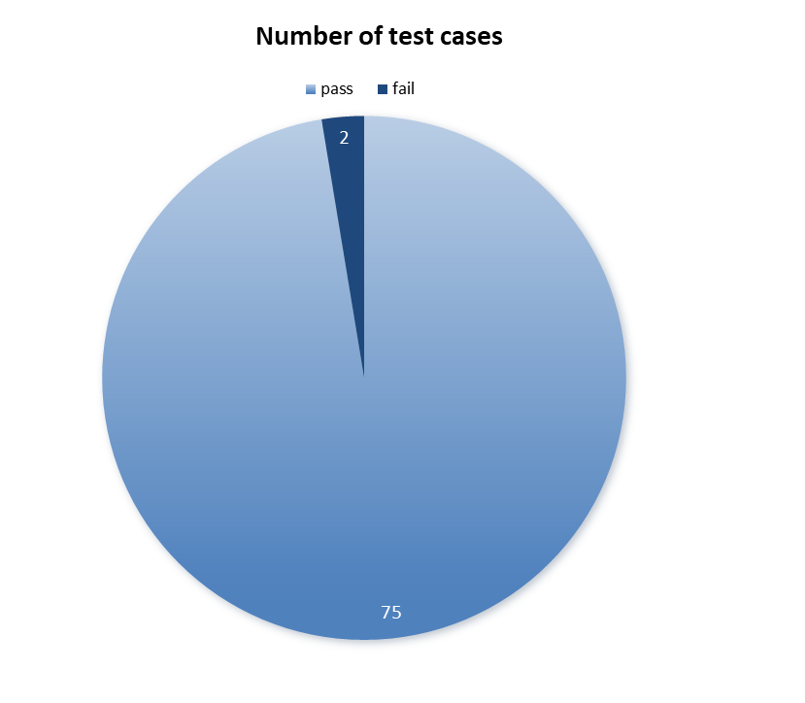
Pie Chart

Slide 17
Requirements-based Test Coverage
06
The goal of requirements-based test coverage is to systematically verify that each requirement is addressed by one or more test cases.

Slide 18


NEEDS
The needs of the main users of this system
01/ Normal use of the system
03/ Booking flights and hotels
Graceful login of users and protection of their information
The normal registration of the user and ensure its legitimacy
Able to enter the user interface normally
The user books flight tickets
The user books hotels
02/ Management of Personal Information
04/ Account Management
The user changes the password
The user changes the payment password
The user modifies his/her personal information
The user checks the account information
The user views hotel and flight information
The user cancels the flight reservation
The user cancels the hotel reservation
02

Slide 19

TEST COVERAGE
Demand categories | Needs number | The test case number corresponding to the requirement
01/ Normal use of the system | Ⅰ | UL_001--UL_013
 | Ⅱ | UR_001--UR_012
 | Ⅲ | UL_001 PC_001-PC_002
02/ Management of Personal Information | Ⅰ | LP_001--LP_004
 | Ⅱ | PP_001--PP_004
 | Ⅲ | UP_001--UP_006
03/ Booking flights and hotels | Ⅰ | FB_001--FB_008
 | Ⅱ | HB_001--HB_010
04/ Account Management | Ⅰ | AI_001--AI_005
 | Ⅱ | FO_001 HO_001--HO_002
 | Ⅲ | FO_002--FO_006
 | Ⅳ | HO_003--HO_007
The test case number retains only the class name and the in-class number.
As shown in the table, the test cases cover all the requirements, and the test coverage of the requirements is 100%
As shown in the table, the test cases cover all the requirements, and the test coverage of the requirements is 100%
02

Slide 20
Defect Metrics
07
The purpose of defect metrics is to systematically measure and analyze the number and severity of defects in a software system.

Slide 21
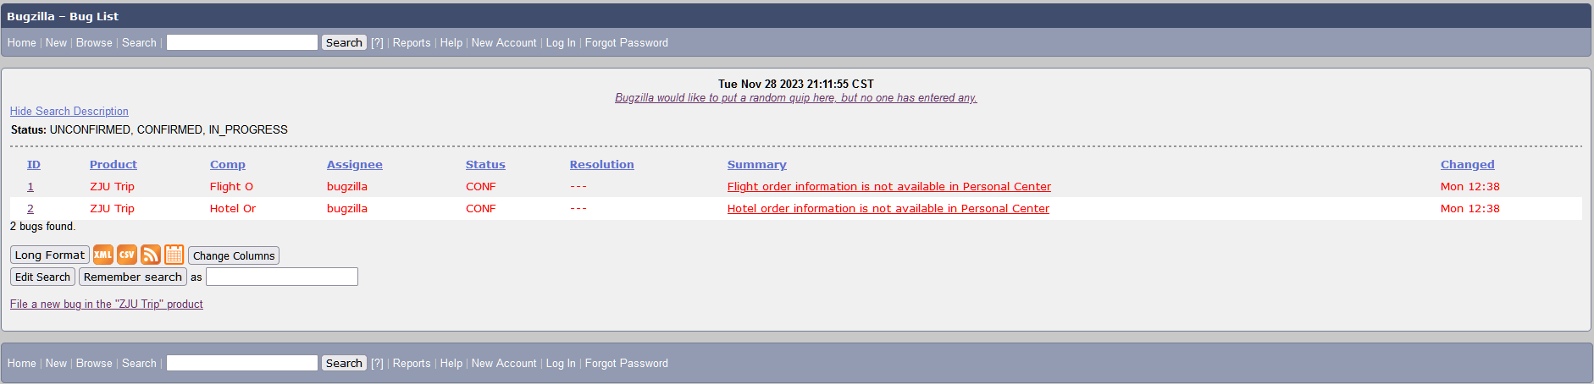


Defect List
We use Bugzilla to track bugs.
02

Slide 22

Defect Summary
Bug ID | Component | Status | Severity | Summary | Root Cause
1 | Flight Order Management | CONFIRMED | Critical | Flight order information is not available in Personal Center. | Parameter error when sending request from frontend to backend.
2 | Hotel Order Management | CONFIRMED | Critical | Hotel order information is not available in Personal Center. | Parameter error when sending request from frontend to backend.
Both bugs are due to front-end code errors.

Slide 23
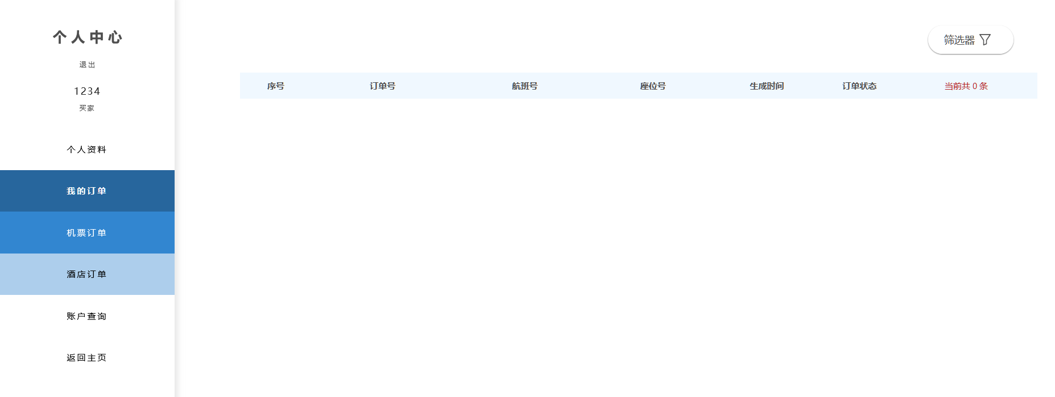
Defect Summary
Hotel and flight order information is not available in Personal Center, only a blank screen is displayed.
(The user has already generated an order)

Slide 24
S-Curve

Slide 25
Risks and Issues
08
The purpose of Risks and Issues is to identify potential pitfalls and problems that may arise in the testing process.

Slide 26
Requirement Analysis
The software requirements themselves being unclear or the development team having an inaccurate understanding of the required features for the system can lead to deviations in the final product functionality, as it may not align with what users truly want.
If there are changes in requirements and the test cases are not promptly updated, it can result in testing risks.

Slide 27
Testcase Coverage
Testing lacks sufficient breadth: It is challenging to cover 100% of user operations, especially in extreme cases that might be overlooked.
Testing lacks sufficient depth: For instance, software defects or bugs may only arise in specific situations, such as under concurrent multi-user conditions. However, testing personnel may neglect these scenarios, with only a few testers exploring these functionalities during testing.

Slide 28
Testing Environment
The test environment set up by testing personnel during the testing process cannot be identical to the user's environment by 100%.
This introduces a certain level of risk because some software defects may only manifest in specific environments, including variations in hardware, operating systems, antivirus software, software patches for different versions, and the actual data that users employ.

Slide 29
Suggested Actions
09
Final test results and recommendations for next steps in development.

Slide 30



SUGGESTED ACTIONS
TEST
CONCLUSION
The project was comprehensively and rigorously tested in a test environment, and the test results showed that the project realized the business of air tickets and hotel reservations. Among them, the pass rate of test cases for Smoke and High priority is 96%, which does not meet our proposed 100% pass standard; The Medium and Low priority pass rates are 100%, which meets our proposed pass criteria of >=95%. The quality of the project test does not meet the requirements and online standards.
Test Conclusion: Failed
Pass rate of the test samples
97%
Pass rate of the test samples（Medium/Low）
Pass rate of the test samples（Smoke/High）
100%
96%
1. Fix the code of the failed test cases
2. Carry out the next round of development process
SUGGESTED
NEXT
STEPS
Need coverage
bug rate of 1,000 lines of code
100%
0.6%
05

